Slide 1

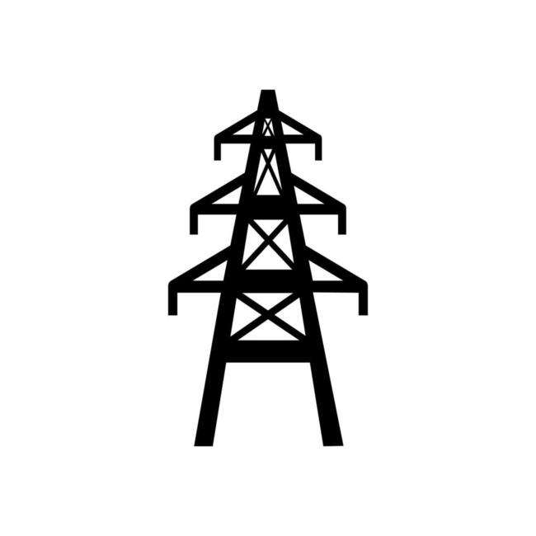
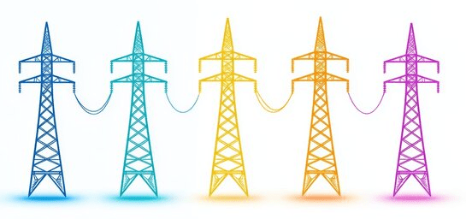
Parametric Study on Structural Efficiency and Economy of Transmission Towers.
SEMINAR ONE PRESENTATION.
Name: Nallajarla Siva Rama Krishna
Roll no: CE24M309
Department of Civil and Environmental Engineering,
Structural engineering
Indian Institute of Technology Tirupati.

Slide 2
Table of content.
1. Intro.
1.1 - Types of transmission towers.
1.2 - Loads on transmission towers.
2. Objective.
3. Parametric study.
3.1 Sections.
3.2 Configuration.
3.3 Base width.
3.4 Bracings system.
3.5 Codes design.
4. Conclusion.
5. Reference.

Slide 3
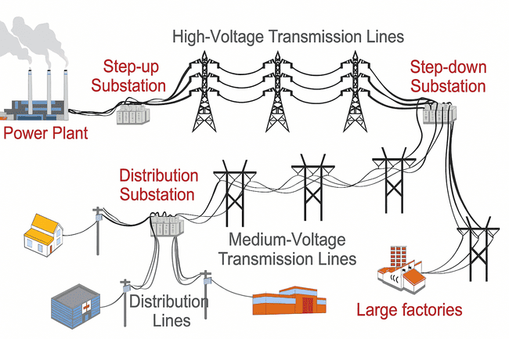
1. Intro.
2. Objective.
3. Parametric study.
4. Conclusion.
5. Reference.
Electric Power Transmission and Distribution Layout.
1.1 - ABOUT THE TRANSMISSION TOWER.
Transmission towers (electrical pylons) carry high-voltage electricity over long distances.
Typical heights range from 50-150 ft (16-45 m) and tallest reach 1,247 ft (380 m).
They connect power plants to substations, linking different grid regions.
Transmission line towers form a major component of the power transmission network, contributing nearly 30 to 40% of the overall project cost.
Inefficient design may lead to excessive deflection, higher steel consumption or increased cost.
Most towers are made of steel, while some use concrete, wood or ductile iron.
https://www.eia.gov/energyexplained/electricity/delivery-to-consumers.php

Slide 4
1. Intro.
2. Objective.
3. Parametric study.
4. Conclusion.
5. Reference.
Types of transmission towers
Current capacity
Material used
Based on circuit
Structure type
a) Single circuit tower
b) Double circuit tower
c) Multi circuit tower.
a) 11 kV,
b) 33 kV
c) 66 kV
d) 110 kV
e) 132 kV
f) 220 kV
g) 400 kV
h) 500 kV
a) Steel Structure
b) Wooden Material
c) RCC Pole
a) Lattice Structure
b) Hybrid Structure
c) Tubular Pole Structure.
Based on angle
Force applied by the conductor on the cross arms
a) A – type tower – angle of deviation 0º to 2º.
b) B – type tower – angle of deviation 2º to 15º.
c) C – type tower – angle of deviation 15º to 30º.
d) D – type tower – angle of deviation 30º to 60º.
e) E – type tower – angle of deviation 60º to 90º.
Tangent suspension tower
Angle tower or tension tower

Slide 5
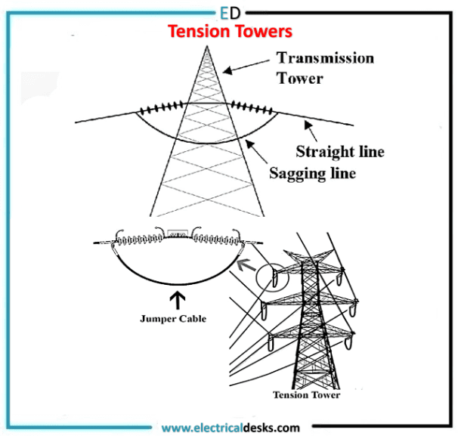
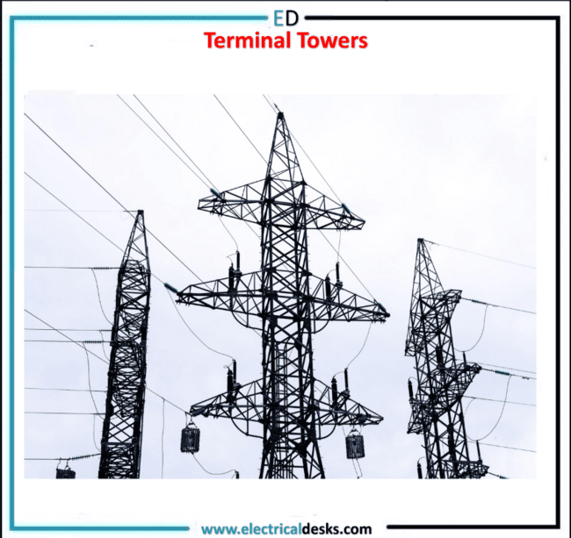
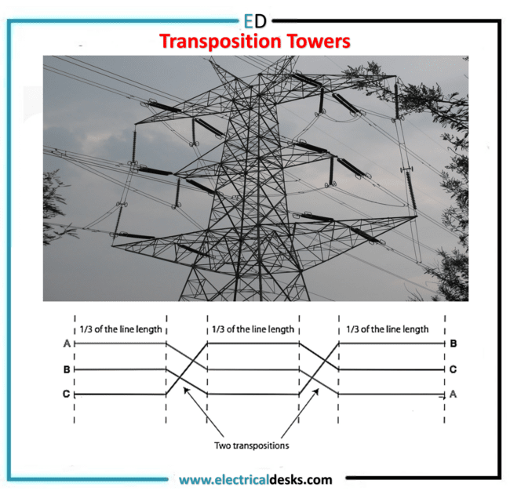
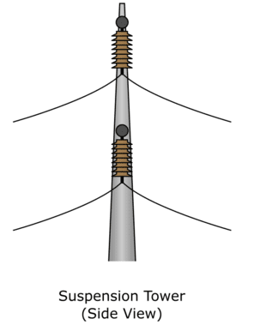
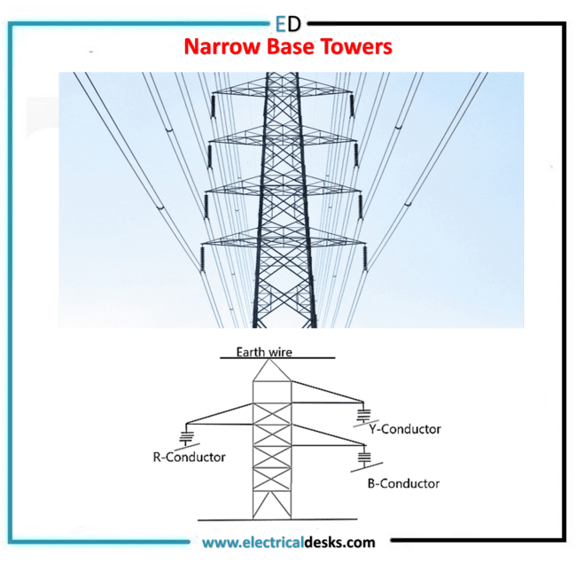
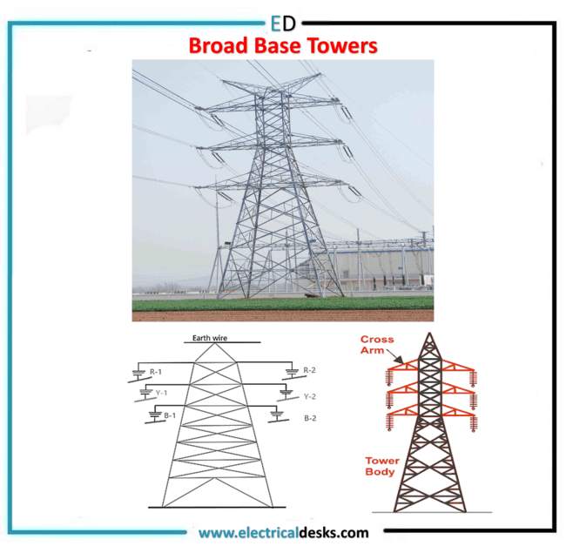
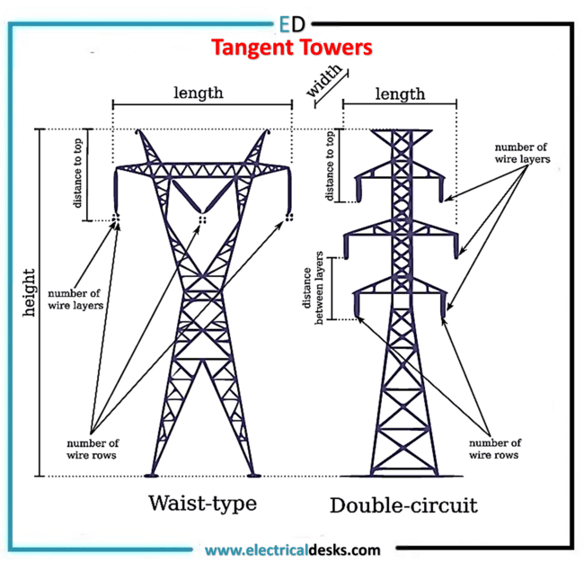
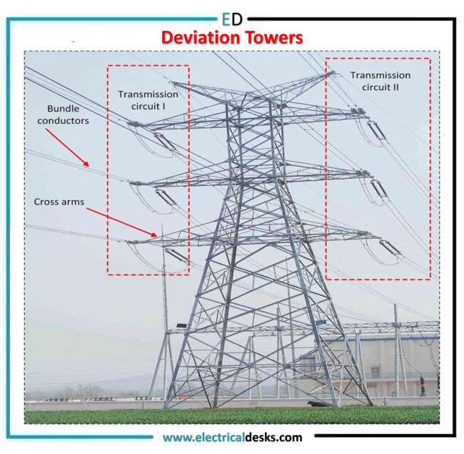
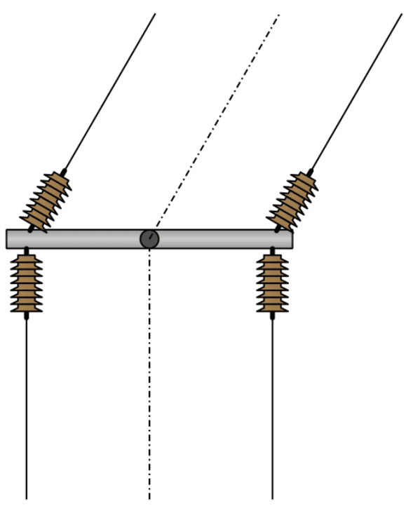
1. Intro.
2. Objective.
3. Parametric study.
4. Conclusion.
5. Reference.

Slide 6
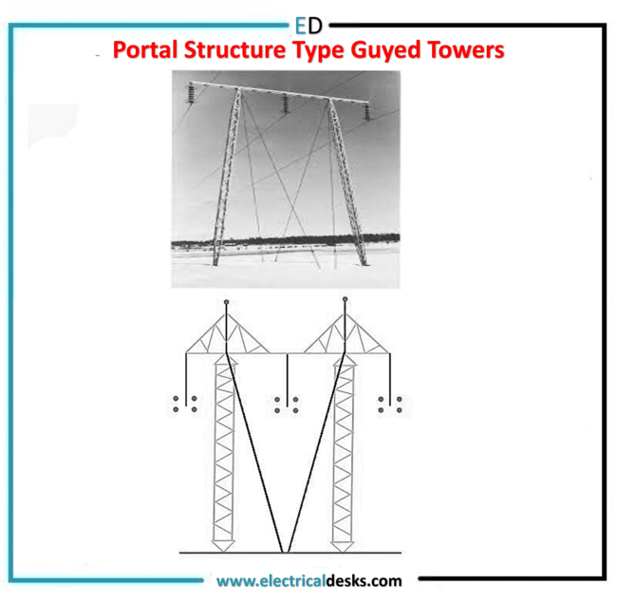
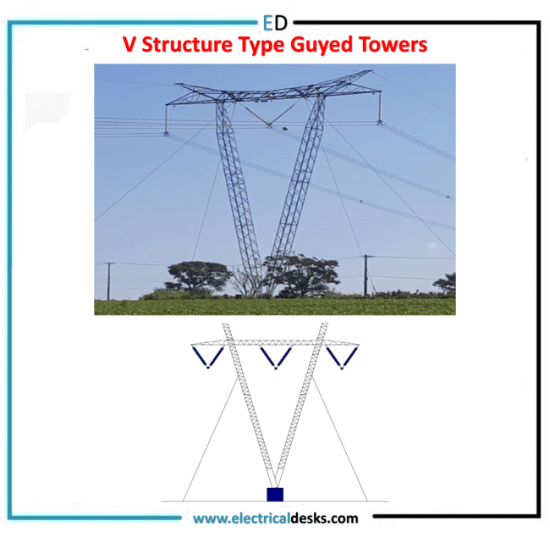
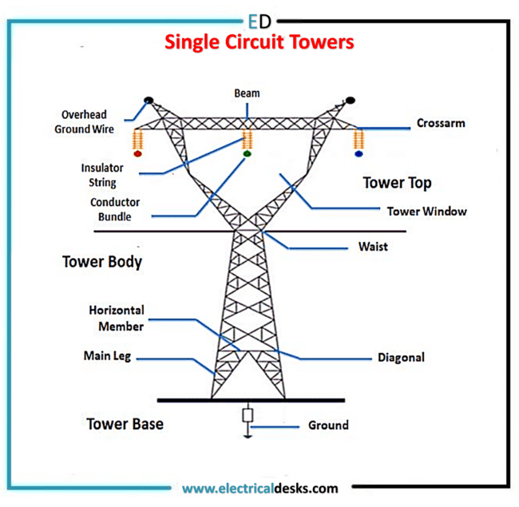
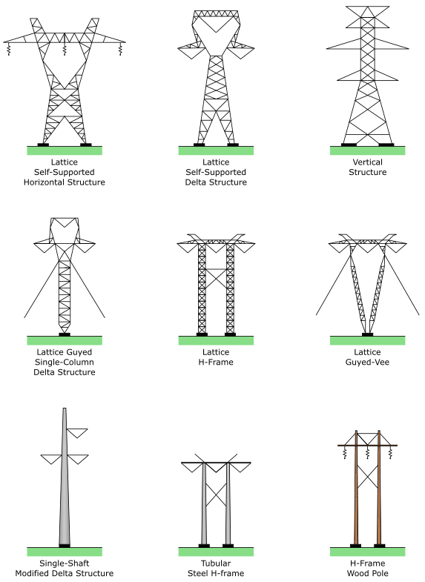
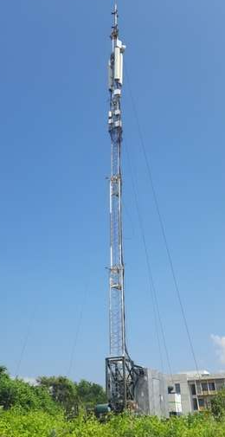
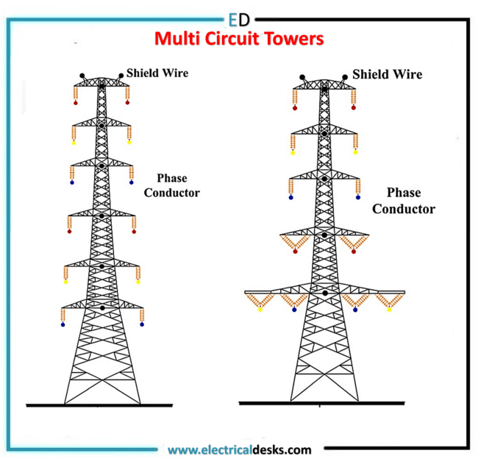
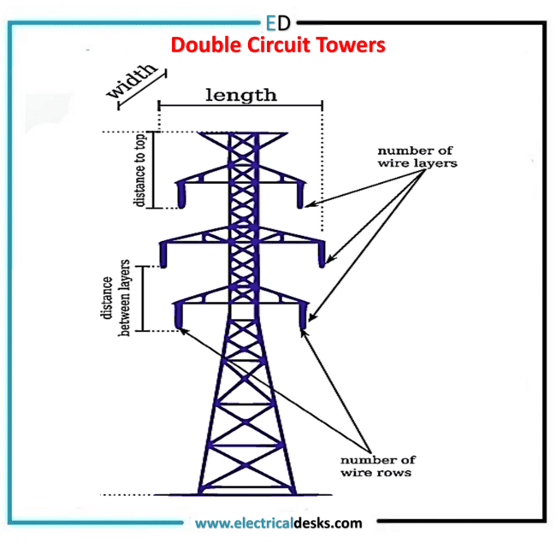
1. Intro.
2. Objective.
3. Parametric study.
4. Conclusion.
5. Reference.
www.savree.com/en/encyclopedia/electrical-transmission-towers
Guyed mast tower at north of IIT Tirupati.

Slide 7
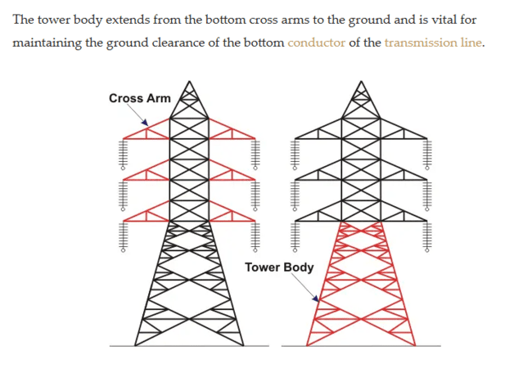
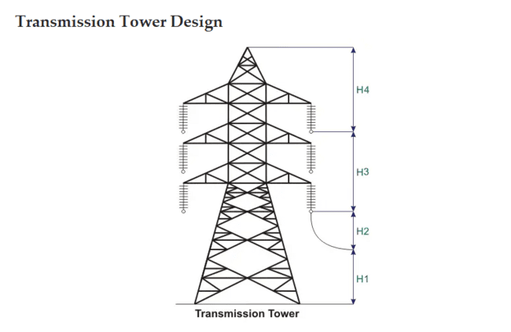
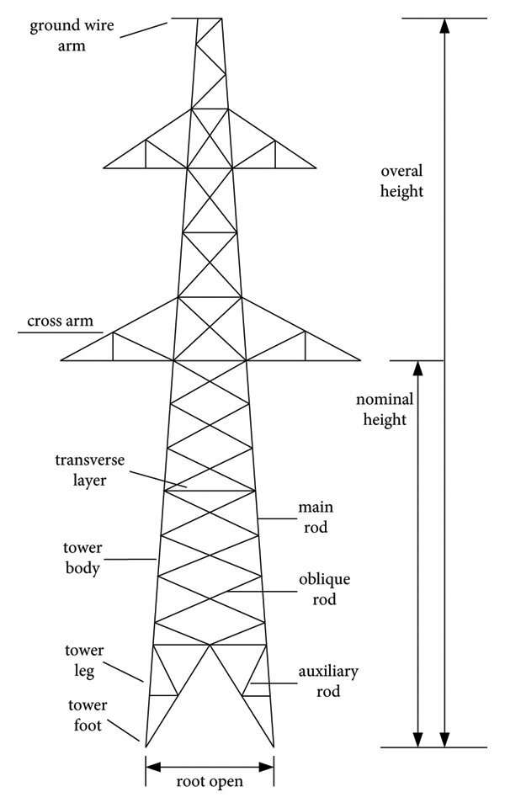
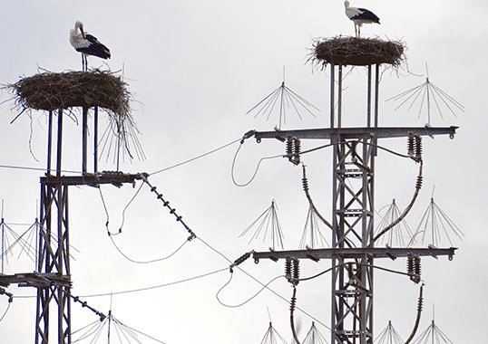
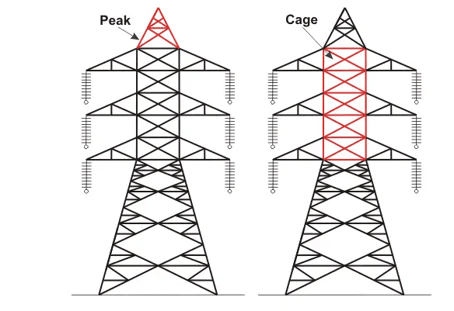
1. Intro.
2. Objective.
3. Parametric study.
4. Conclusion.
5. Reference.
Fig. - Nesting platform for bird nesting.
Minimum permissible ground clearance (H1).
Maximum sag of overhead conductor (H2).
Vertical spacing between the top and bottom conductors (H3).
Vertical clearance between the ground wire
and top conductor (H4).
https://www.electrical4u.com/electrical-transmission

Slide 8
1. Intro.
2. Objectives.
3. Parametric study.
4. Conclusion.
5. Reference.
To select the efficient configuration (VCT and HCT) of towers.
To select the efficient bracing configuration.
To decide the efficient code for tower design.
To select the effective base width for the different wind zones.
To select the best sections out of angle and hollow tube sections.

Slide 9
1. Intro.
2. Objective.
3. Parametric study.
4. Conclusion.
5. Reference.
Parameters.
Bracing
Base width
Configuration
Sections
Codes
In different wind zones :-
Z-1
Z-2
Z-3
Z-4
Z-5
Z-6
Angular
Tubular
Is 802
Is 800
AISC
EN
K type
X type
Diagonal
XD
Combined
Vertical
Horizontal

Slide 10
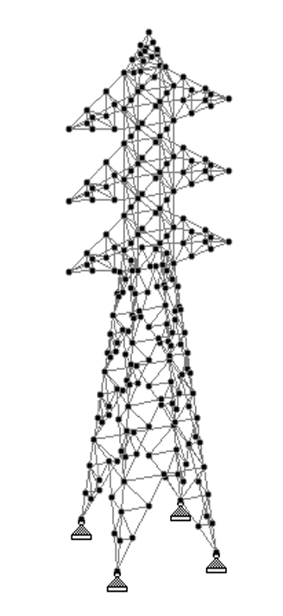
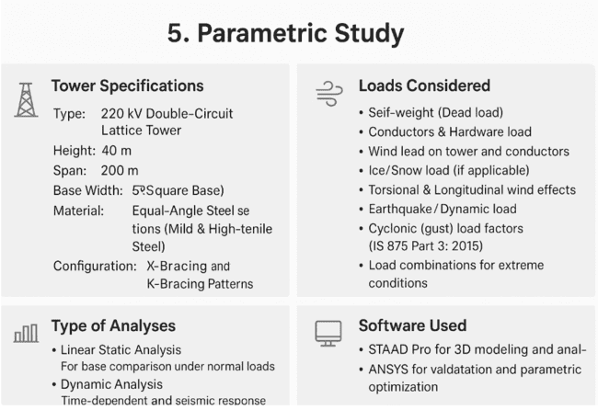



1. Intro.
2. Objective.
3. Parametric study.
4. Conclusion.
5. Reference.
5.1 - SECTIONS COMPARASION^{[1]}.
1. Tower Specifications.
3. Loads Considered.
Type - | Four legged suspended tower of 400 KV double circuit.
Height - | 40 m.
Sections - | Angle and closed hollow section.
Configuration- | X-Bracing and K-Bracing Patterns.
Self-weight (Dead load)
Conductors & Hardware load
Wind load on tower and conductors
Ice/Snow load (if applicable)
Earthquake/Dynamic load
Load combinations for extreme conditions
4. Soft ware Used
2. Tower Analyses.
STAAD Pro for 3D modeling and analysis.
Linear Static Analysis.
Dynamic analysis.
One broken wire and anti-cascading condition.
Indian code is 802 part1.
Fig - Four legged suspended tower.
Cont.
(IJAERD), vol. 4, 2017.

Slide 11
1. Intro.
2. Objective.
3. Parametric study.
4. Conclusion.
5. Reference.
5 - Parameters used to decide which section is better.
Structural Deflection.
Economy (Weight and Cost).
Permissible Limits Check.
6 - RESULTS.
83.2
12,50,000
75
65
68
15,00,000
Fig. - Deflections for various sections.
Fig - Costs for various sections.
Cont.

Slide 12
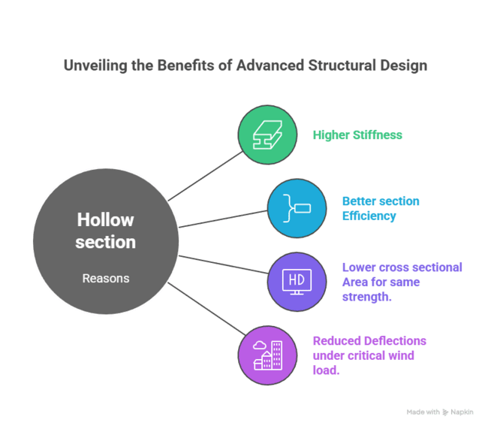
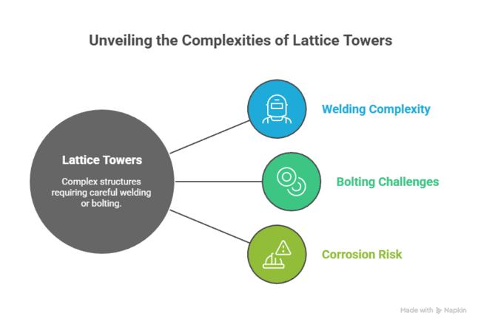
1. Intro.
2. Objective.
3. Parametric study.
4. Conclusion.
5. Reference.
7 - Observations.
Best section was concluded as the four-legged transmission tower with “Closed Hollow Sections” since it was both structurally stiffer and more economical.
8 - Reasons.
9 - Challenges with Hollow Sections.

Slide 13
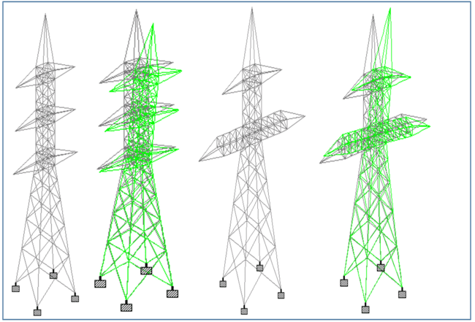
1. Intro.
2. Objective.
3. Parametric study.
4. Conclusion.
5. Reference.
5.2 - CONFIGURATION TYPES^{[2]}.
1. Tower Specifications.
Type - | 132 kV double circuit self-supporting angle tower.
Height - | HCT = 38.83 m & VCT = 44.85m
Span - | 200 m
Base Width - | 7.6 m for both VCT and HCT.
Material - | Mild steel and High tensile steel.
Configuration- | Vertical Configured Tower and Horizontal configured tower.
VCT
HCT
2. Tower Analyses.
3. Loads Considered.
Linear Static Analysis.
Self-weight (Dead load)
Conductors & Hardware load
Wind load on tower and conductors
Ice/Snow load (if applicable)
Earthquake/Dynamic load
Soft ware Used
STAAD Pro for 3D modeling and analysis.

Slide 14
1. Intro.
2. Objective.
3. Parametric study.
4. Conclusion.
5. Reference.
4. GRAPHS.
Cont.

Slide 15
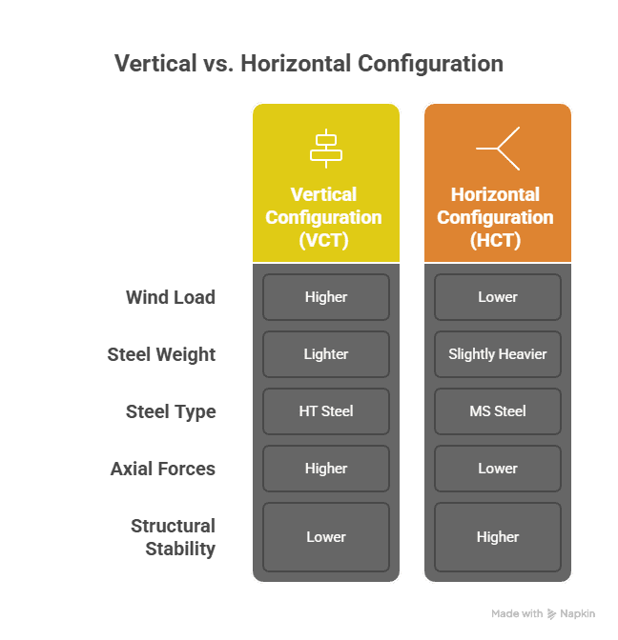
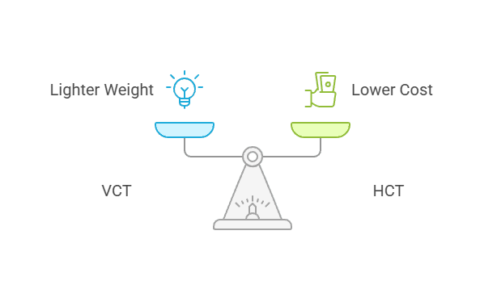
1. Intro.
2. Objective.
3. Parametric study.
4. Conclusion.
5. Reference.
5. OBSERVATIONS.
6. REASONS.
Choose between weight and cost savings.
Vertical vs Horizontal Configuration.
HCT

Slide 16
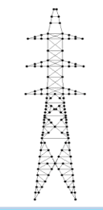
1. Intro.
2. Objective.
3. Parametric study.
4. Conclusion.
5. Reference.
5.3 - BASE WIDTH COMPARASION^{[3]}.
1. Tower Specifications.
3. Loads Considered.
Type - | Self-supporting lattice steel transmission tower
Height - | 34.120 m
Top width - | 0.5 m
Base Width - | 6.307 m
Cross arm length - | 9.2 m
Material - | Steel (Fe415)
Sections used - | ISA
Self-weight (Dead load)
Conductors & Hardware load
Wind load on tower and conductors
Ice/Snow load (if applicable)
Torsional & Longitudinal wind effects
4. Soft ware Used
2. Tower Analyses.
Linear Static Analysis: For base comparison under normal loads.
STAAD Pro for 3D modeling and analysis.

Slide 17
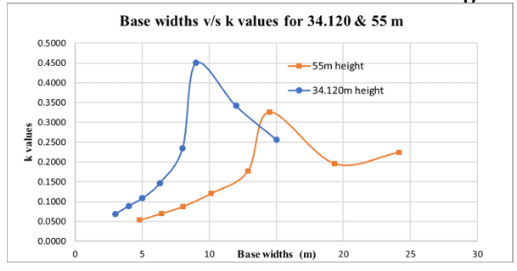
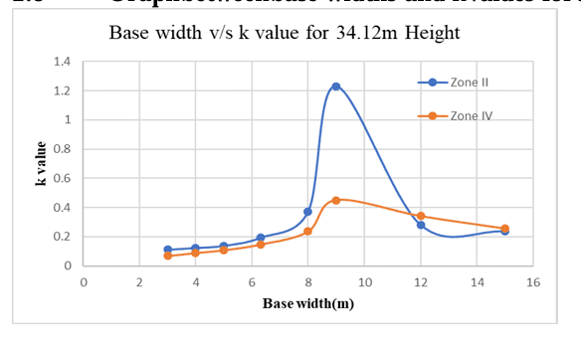
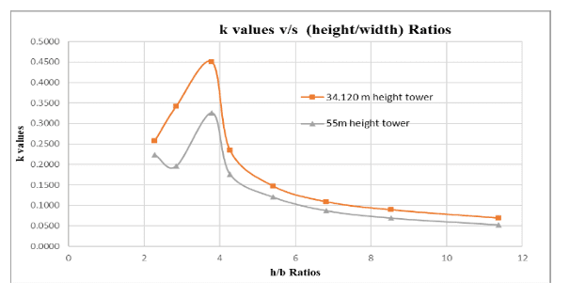
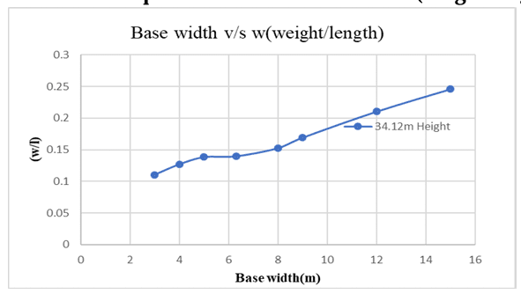
1. Intro.
2. Objective.
3. Parametric study.
4. Conclusion.
5. Reference.
5. GRAPHS.
5.1 Graph between k values and base widths for 34.120m and 55m heights.
5.3 Graph between base widths and k values for 34.12m height.
5.2 Graph between k values and height to width ratios for 34.120m and 55m heights.
5.4 Graph between base widths and (weight/length) values for 34.12m Height.
Cont.

Slide 18
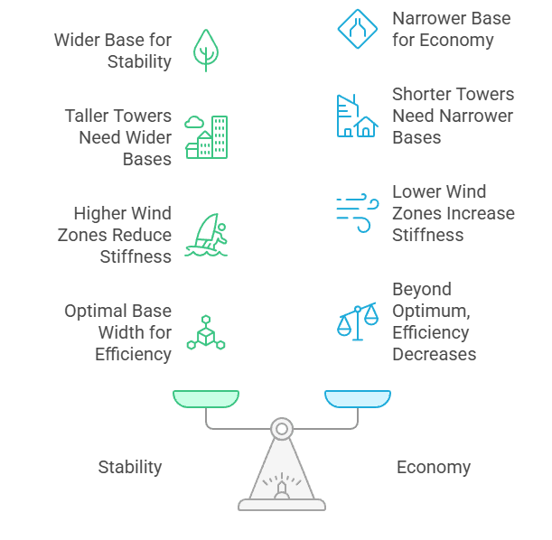
1. Intro.
2. Objective.
3. Parametric study.
4. Conclusion.
5. Reference.
6. OBSERVATIONS.
7. REASONS.
Optimum Stability vs. Economy:
Wider bases improve tower stability and reduce deflection under wind loads.
2. Height-to-Base Ratio (h/b = 3.79):
This ratio ensures adequate stiffness while keeping the tower design economical.
3. Wind Zone Adaptability:
Base widths are chosen to suit different wind zones, increasing slightly for higher wind speeds.
This provides better resistance to lateral loads without overdesigning for low-wind areas.
9 m for 34.12 m tower (k = 0.45).
14.5 m for 55 m tower (k = 0.345).
Towers in higher wind zones (Zone IV) require slightly wider bases for the same height compared to Zone II.
Cont.

Slide 19
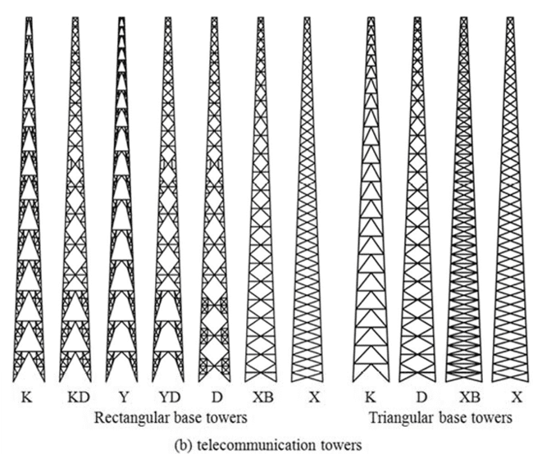
1. Intro.
2. Objective.
3. Parametric study.
4. Conclusion.
5. Reference.
5.4 - BRACING COMPARASION^{[4]}.
1. Tower Specifications.
2. Loads Considered.
Type - | Self-supporting lattice tower.
Height - | 27 m – 55 m (up to 75 m for 500 kV).
Height range - | 27 m – 55 m (up to 75 m for 500 kV).
Base Width - | 4 m – 10 m (varied for optimization).
Material -
Configuration- | K, X, Diamond (D), Single Diagonal, Cross-Diagonal, KD, Y, YD, XBX, Pratt, KX.
Dead Load, Wind Load, Longitudinal Load, Vertical Load, Seismic Load, Temperature Load and Dynamic Load.
4. Bracing considered.
3. Tower Analyses.
Linear and non linear Static Analysis.
Soft ware Used
STAAD Pro for 3D modeling and analysis

Slide 20
1. Intro.
2. Objective.
3. Parametric study.
4. Conclusion.
5. Reference.
5. GRAPHS.
Radar graphs.
Cont.

Slide 21
1. Intro.
2. Objective.
3. Parametric study.
4. Conclusion.
5. Reference.
6. OBSERVATIONS.
Bracing configuration governs both economy and stiffness.
X-bracing generally yields minimum weight and uniform force distribution.
K-bracing offers higher stiffness but adds steel.
Diamond (D) and Cross-diagonal are good compromises.
KD/YD suitable for telecom towers (tall, slender).
7. REASONS.
Bracing | Structural Behaviour | Reason for Efficiency
X-Bracing | Direct tension–compression path; symmetrical load transfer. | Minimum deflection & weight → most economical.
D / Diamond | Secondary diagonal reduces unbalanced forces. | Stable, uniform stress distribution.
K-Bracing | Redundant members, higher stiffness. | Lower deflection but heavier; useful in high-wind zones.
KD / YD | Combined K & diagonal system. | Good economy for tall slender telecom towers.
XBX / Cross-Diagonal | Multiple load paths. | Balanced between stiffness & weight.

Slide 22
1. Intro.
2. Objective.
3. Parametric study.
4. Conclusion.
5. Reference.
5.5 - CODE COMPARASION^{[5]}.
1 Tower Specifications.
2 Loads Considered.
Type - | 220 kV Double-Circuit Lattice Tower
Height - | 40 m
Span - | 200 m
Base Width- | 5.95 m (Square Base)
Material- | Equal-Angle Steel Sections (Mild and High-Tensile Steel)
Configuration- | X-Bracing and K-Bracing Patterns
Self-weight (Dead load)
Conductors & Hardware load
Wind load on tower and conductors
Ice/Snow load (if applicable)
Torsional & Longitudinal wind effects
Earthquake/Dynamic load
Cyclonic (gust) load factors (IS 875 Part 3: 2015)
Load combinations for extreme conditions
3 Tower Analyses.
4 Soft ware Used
Linear Static Analysis - For base comparison under normal loads.
Dynamic Analysis - Time-dependent and seismic response.
STAAD Pro for 3D modeling and analysis
ANSYS for validation and parametric optimization

Slide 23
1. Intro.
2. Objective.
3. Parametric study.
4. Conclusion.
5. Reference.
5 - GRAPHS.
1
2
Cont.

Slide 24
1. Intro.
2. Objective.
3. Parametric study.
4. Conclusion.
5. Reference.
6 - OBSERVATIONS
Wind load is the most critical factor in tower design, especially in cyclone-prone regions.
IS 802 (2015) needs revision to include k₄ factor for cyclonic safety (as adopted in IS 875 (2015)).
IS 802 (2015) is adequate for normal zones but unsafe in coastal Wind Zone 5 without modification.
ASCE 10-97/10-15 and BS EN 1993-3-1 give more accurate and reliable load estimations for extreme winds and slender members.
7 - Recommended / Best Code and Reasons.
Best Performing Code: IS 875 (Part 3): 2015 + ASCE 10-15 combination (or IS 802 revised with k₄ factor = 1.3).
Reasons:
  Accounts for cyclonic gust effects via importance factor (k₄).
  Harmonized with international reliability-based design methods.
  Produces safe, economical, and performance-based results in high wind zones.
  Reflects current understanding of fluctuating and directional wind loading on lattice towers.

Slide 25
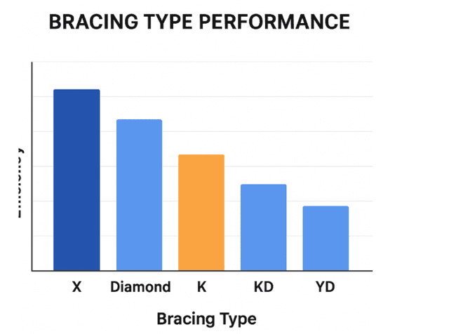
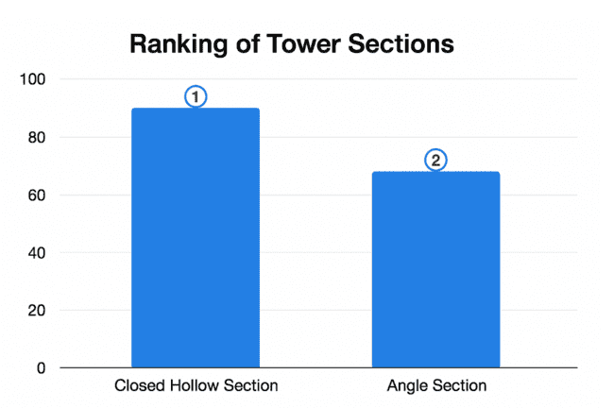
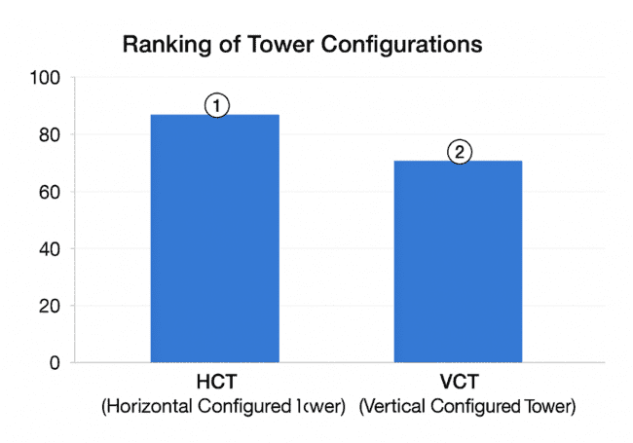
1. Intro.
2. Objective.
3. Parametric study.
4. Conclusion.
5. Reference.
1. Efficient bracings.
X-bracing offers the most efficient balance of stiffness, strength, and economy by uniformly distributing loads and minimizing deflection.
Compared to K, Diamond, and KD patterns, it ensures greater stability with lower steel consumption, making it the most suitable choice for transmission tower design.
2. Efficient section.
Closed hollow sections are more efficient than traditional angle sections, offering higher stiffness and lower deflection under wind and seismic loads.
Despite slightly complex fabrication, they provide superior strength-to-weight performance and improved overall structural efficiency.
3. Efficient configuration.
The horizontal configuration (HCT) is the most economical and practical design, offering stable performance with lower wind loads.
Although slightly heavier, it allows the use of mild steel instead of high-tensile steel, resulting in significant cost savings.

Slide 26
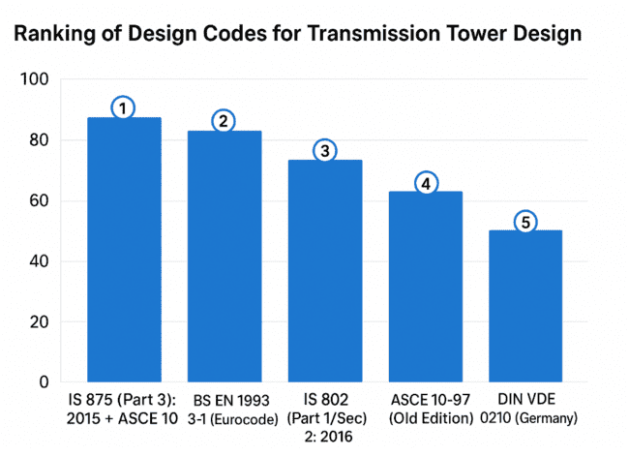
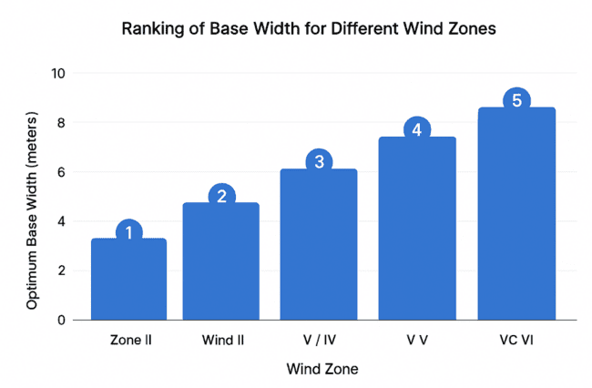
1. Intro.
2. Objective.
3. Parametric study.
4. Conclusion.
5. Reference.
4. Efficient code for design.
The IS 875 (Part 3): 2015 + ASCE 10-15 combination ensures safe and economical tower design by incorporating the k₄ factor for cyclonic and directional wind effects.
A revised IS 802 with k₄ = 1.3 is essential for achieving reliable performance in coastal and high-wind regions.
5. Efficient base width.
The optimum base width depends on tower height and wind zone, balancing both stability and economy.
An ideal height-to-width ratio maximizes structural efficiency while minimizing excess steel and cost about 9 m for 34.12 m towers and 14.5 m for 55 m towers offer the best performance.

Slide 27
1. Intro.
2. Objective.
3. Parametric study.
4. Conclusion.
5. Reference.
[1] Comparative Study of Four-Legged Lattice Transmission Tower Having Angle and Hollow Sections, International Journal of Advance Engineering and Research Development (IJAERD), vol. 4, 2017.
[2] Analysis and Design of Vertical and Horizontal Configurations of Cross-Arms in a Transmission Line Tower, IJERT, vol. 4, 2015.
[3] M. N. Shyamenahalli and C. D. M. Determination of Economic Base Width of Transmission Tower for Different Wind Zones, International Journal of Research in Engineering and Science (IJRES), vol. 9, 2021.
[4] Abdulaqder M. Tah, Kamiran M. Asilevani, & Mustafa Özaçka. (2017). Comparison of Various Bracing System for Self-Supporting Steel Lattice Structure Towers. American Journal of Civil Engineering.
[5] Harsha Jatwa, Vivek Tiwari, & Sumit Pahwa. (2017). Comparative Study of Indian and ASCE Codes Provision for Design of Transmission Tower. International Journal of Innovations in Engineering and Technology (IJIET), vol. 9.

Slide 28

The Land of Giants.
By Choi+Shine Architects (south Korea).
THANK YOU

